Slide 1
Applied Cryptography group, ring, field, shift cipher, affine cipher, Hill cipher, substitution cipher, permutation Cipher
Liangfeng Zhang
School of Information Science and Technology
ShanghaiTech University

Slide 2

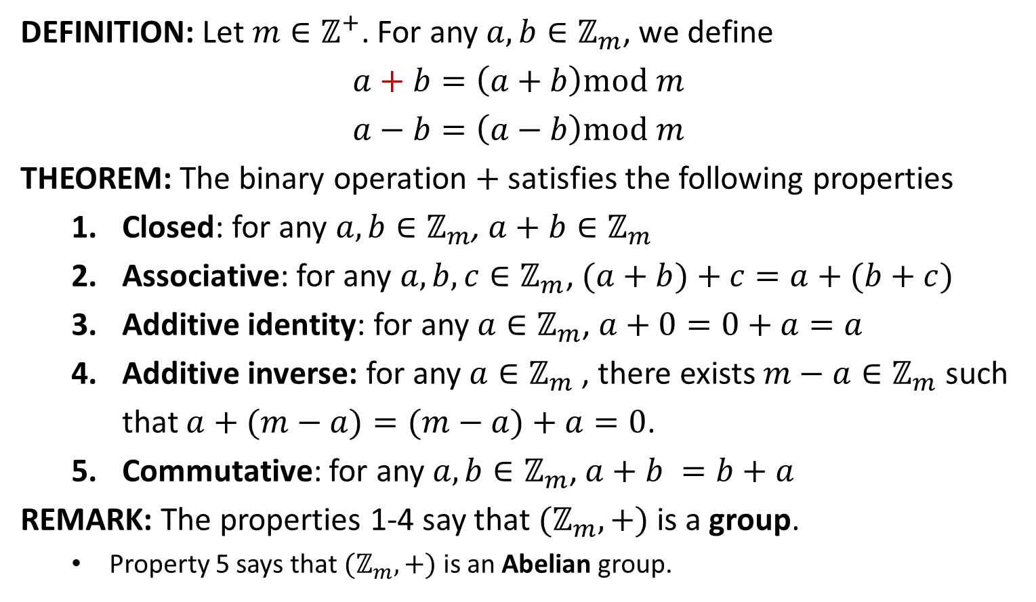
$$\text{Group} ℤ_{m}$$
DEFINITION: Let $m∈ℤ^{+}$. For any $a,b∈ℤ_{m}$, we define
$$a+b=\left(a+b\right)mod m$$
$$a−b=\left(a−b\right)mod m$$
THEOREM: The binary operation $+$ satisfies the following properties
Closed: for any $a, b∈ℤ_{m}$, $a+b∈ℤ_{m}$
Associative: for any $a, b, c∈ℤ_{m}$, $(a+b)+c=a+(b+c)$
Additive identity: for any $a∈ℤ_{m}$, $a+0=0+a=a$
Additive inverse: for any $a∈ℤ_{m}$, there exists $m−a∈ℤ_{m}$ such that $a+(m−a)=(m−a)+a=0$.
Commutative: for any $a, b∈ℤ_{m}$, $a+b =b+a$
REMARK: The properties 1-4 say that $(ℤ_{m},+)$ is a group.
Property 5 says that $(ℤ_{m},+)$ is an Abelian group.

Slide 3

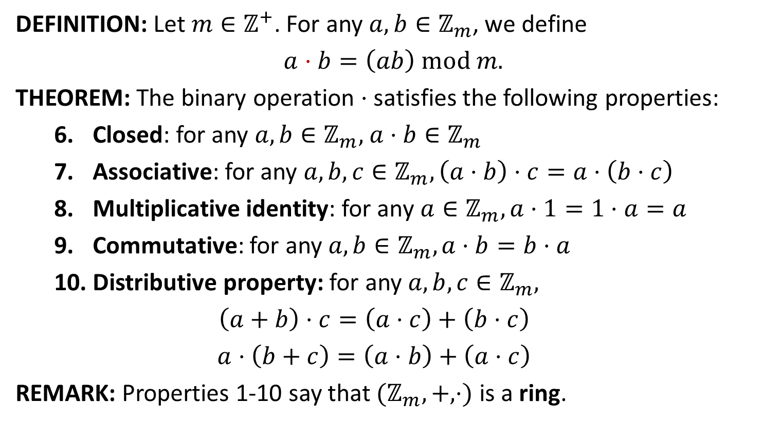
Ring $ℤ_{m}$
DEFINITION: Let $m∈ℤ^{+}$. For any $a,b∈ℤ_{m}$, we define
$$a⋅b=\left(ab\right) mod m.$$
THEOREM: The binary operation $⋅$ satisfies the following properties:
Closed: for any $a, b∈ℤ_{m}\text{,} a⋅b∈ℤ_{m}$
Associative: for any $a, b, c∈ℤ_{m}, \left(a⋅b\right)⋅c=a⋅\left(b⋅c\right)$
Multiplicative identity: for $\text{any} a∈ℤ_{m}, a⋅1=1⋅a=a$
Commutative: for any $a, b∈ℤ_{m}, a⋅b=b⋅a$
Distributive property: for any $a, b, c∈ℤ_{m},$
$$\left(a+b\right)⋅c=\left(a⋅c\right)+\left(b⋅c\right)$$
$$a⋅\left(b+c\right)=\left(a⋅b\right)+\left(a⋅c\right)$$
REMARK: Properties 1-10 say that $(ℤ_{m},+,⋅)$ is a ring.

Slide 5
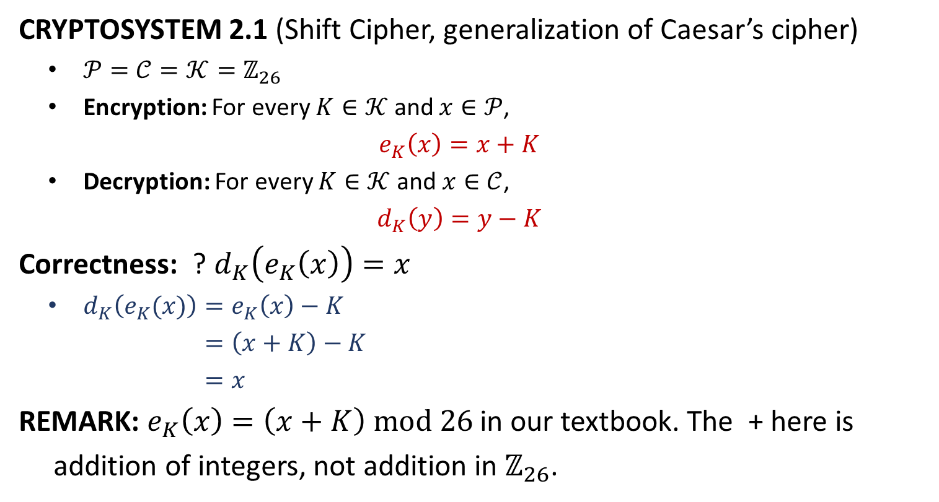
Shift Cipher
CRYPTOSYSTEM 2.1 (Shift Cipher, generalization of Caesar’s cipher)
$𝒫=𝒞=𝒦=ℤ_{26}$
Encryption: For every $K∈𝒦$ and $x∈𝒫$,
$$e_{K}\left(x\right)=x+K$$
Decryption: For every $K∈𝒦$ and $x∈𝒞$,
$$d_{K}\left(y\right)=y−K$$
Correctness: ? $d_{K}\left(e_{K}\left(x\right)\right)=x$
$d_{K}\left(e_{K}(x)\right)=e_{K}\left(x\right)−K$
$=\left(x+K\right)−K$
$=x$
REMARK: $e_{K}\left(x\right)=\left(x+K\right) mod 26$ in our textbook. The + here is
addition of integers, not addition in $ℤ_{26}$.

Slide 6
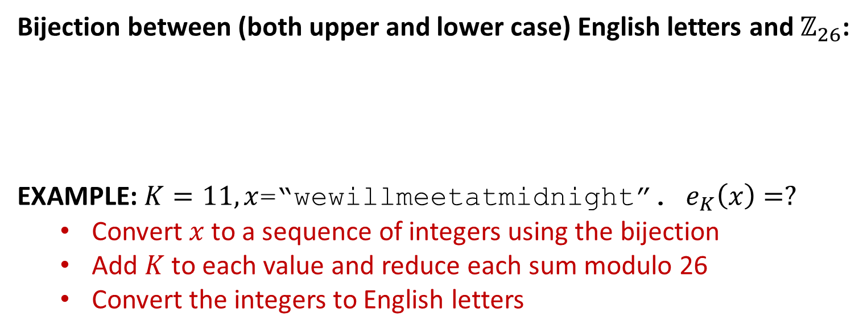
Shift Cipher
Bijection between (both upper and lower case) English letters and $ℤ_{26}$:
EXAMPLE: $K=11, x$=“wewillmeetatmidnight”. $e_{K}\left(x\right)=?$
Convert $x$ to a sequence of integers using the bijection
Add $K$ to each value and reduce each sum modulo 26
Convert the integers to English letters
A | B | C | D | E | F | G | H | I | J | K | L | M
0 | 1 | 2 | 3 | 4 | 5 | 6 | 7 | 8 | 9 | 10 | 11 | 12
N | O | P | Q | R | S | T | U | V | W | X | Y | Z
13 | 14 | 15 | 16 | 17 | 18 | 19 | 20 | 21 | 22 | 23 | 24 | 25
w
e
w
i
l
l
m
e
e
t
a
t
m
i
d
n
i
g
h
t
22
4
22
8
11
11
12
4
4
19
0
19
12
8
3
13
8
6
7
19
7
15
7
19
22
22
23
15
15
4
11
4
23
19
14
24
19
17
18
4
H
P
H
T
W
W
X
P
P
E
L
E
X
T
O
Y
T
R
S
E

Slide 8
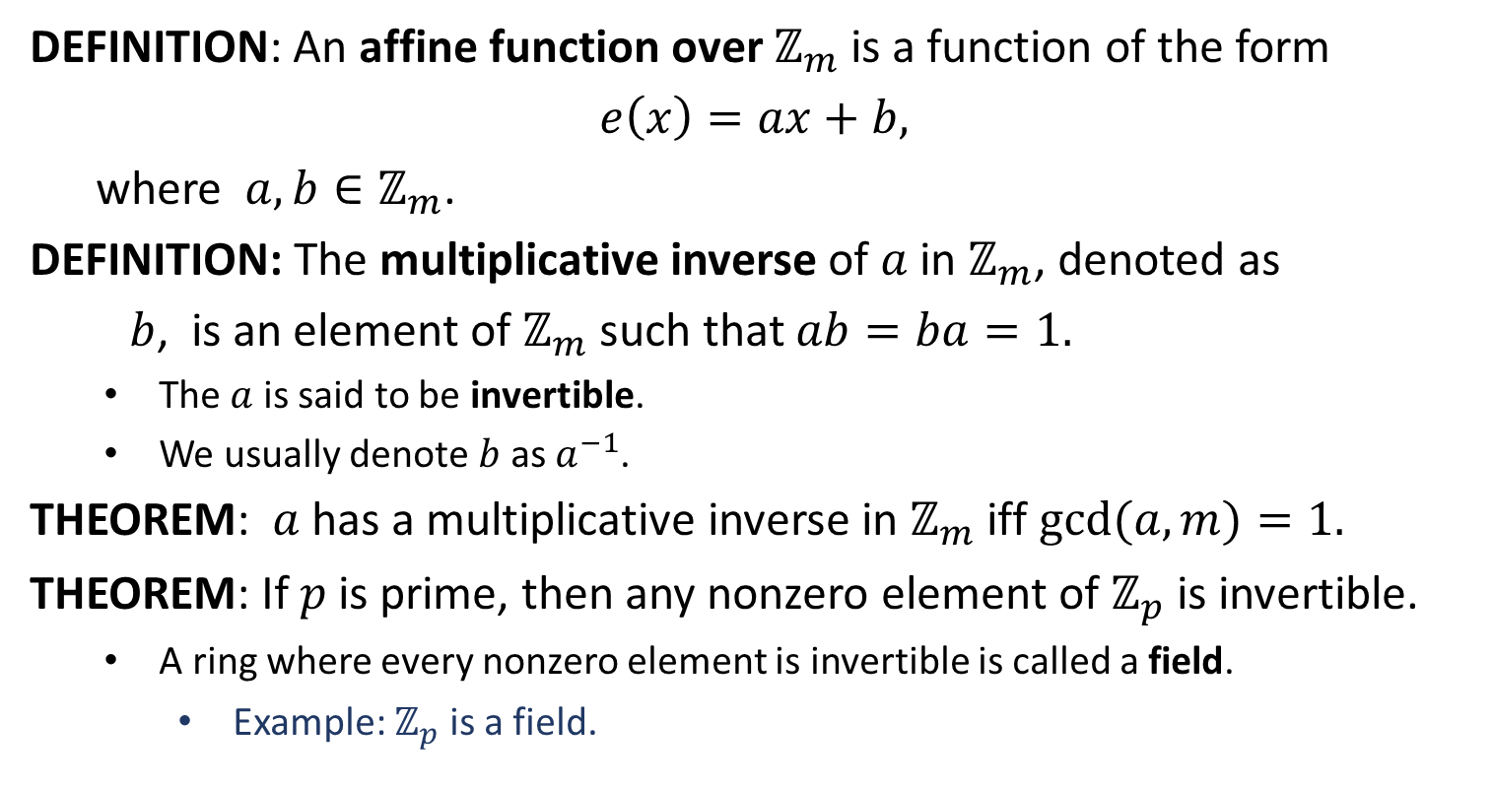

Multiplicative Inverse in $ℤ_{m}$
DEFINITION: An affine function over $ℤ_{m}$ is a function of the form
$$e\left(x\right)=ax+b,$$
where $a, b∈ℤ_{m}$.
DEFINITION: The multiplicative inverse of $a$ in $ℤ_{m}$, denoted as
$b$, is an element of $ℤ_{m}$ such that $ab=ba=1.$
The $a$ is said to be invertible.
We usually denote $b$ as $a^{−1}$.
THEOREM: $a$ has a multiplicative inverse in $ℤ_{m}$ iff $gcd⁡(a,m)=1.$
THEOREM: If $p$ is prime, then any nonzero element of $ℤ_{p}$ is invertible.
A ring where every nonzero element is invertible is called a field.
Example: $ℤ_{p}^{ }$ is a field.

Slide 9
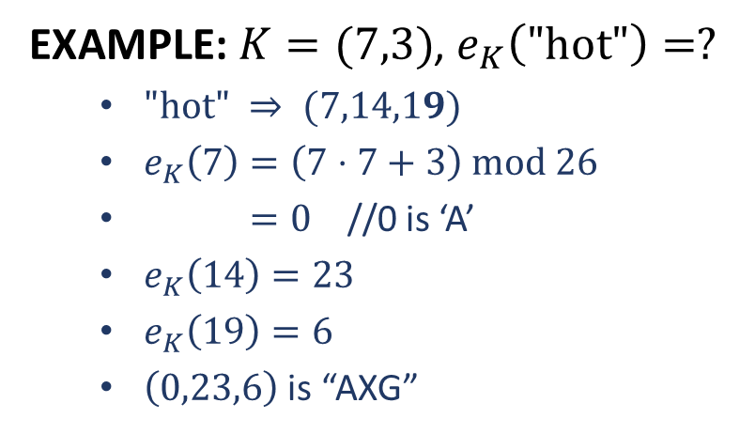
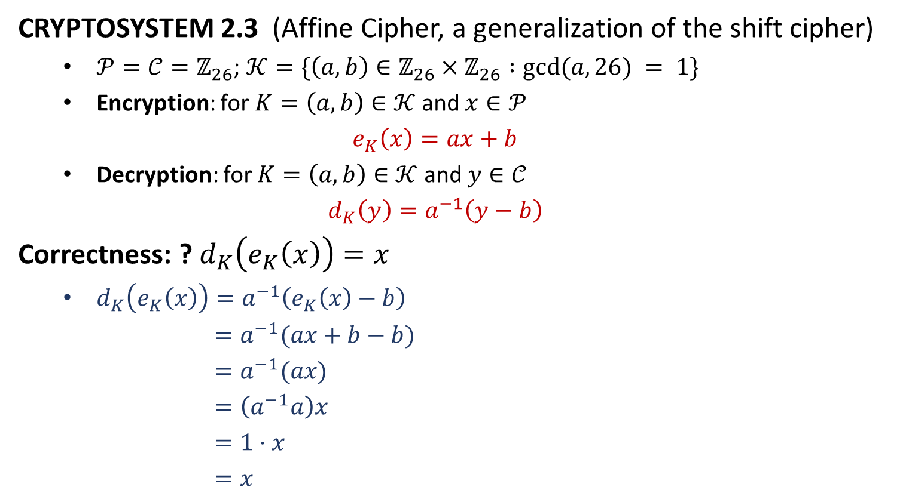
Affine Cipher
CRYPTOSYSTEM 2.3 (Affine Cipher, a generalization of the shift cipher)
$𝒫=𝒞=ℤ_{26}$; $𝒦=\{\left(a, b\right)∈ℤ_{26}×ℤ_{26} :gcd⁡(a, 26) = 1\}$
Encryption: for $K=\left(a,b\right)∈𝒦$ and $x∈𝒫$
$$e_{K}\left(x\right)=ax+b$$
Decryption: for $K=\left(a,b\right)∈𝒦$ and $y∈𝒞$
$$d_{K}\left(y\right)=a^{−1}\left(y−b\right)$$
Correctness: ? $d_{K}\left(e_{K}\left(x\right)\right)=x$
$d_{K}\left(e_{K}\left(x\right)\right)=a^{−1}\left(e_{K}\left(x\right)−b\right)$
$=a^{−1}(ax+b−b)$
$=a^{−1}(ax)$
$=\left(a^{−1}a\right)x$
$=1⋅x$
$=x$
EXAMPLE: $K=(7,3)$, $e_{K}\left(\text{"}\text{hot}\text{"}\right)=?$
$\text{"}\text{hot}\text{"} ⇒ (7,14,19)$
$e_{K}\left(7\right)=\left(7⋅7+3\right) mod 26$
$=0$ //0 is ‘A’
$e_{K}\left(14\right)=23$
$e_{K}\left(19\right)=6$
$\left(0,23,6\right)$ is “AXG”

Slide 11

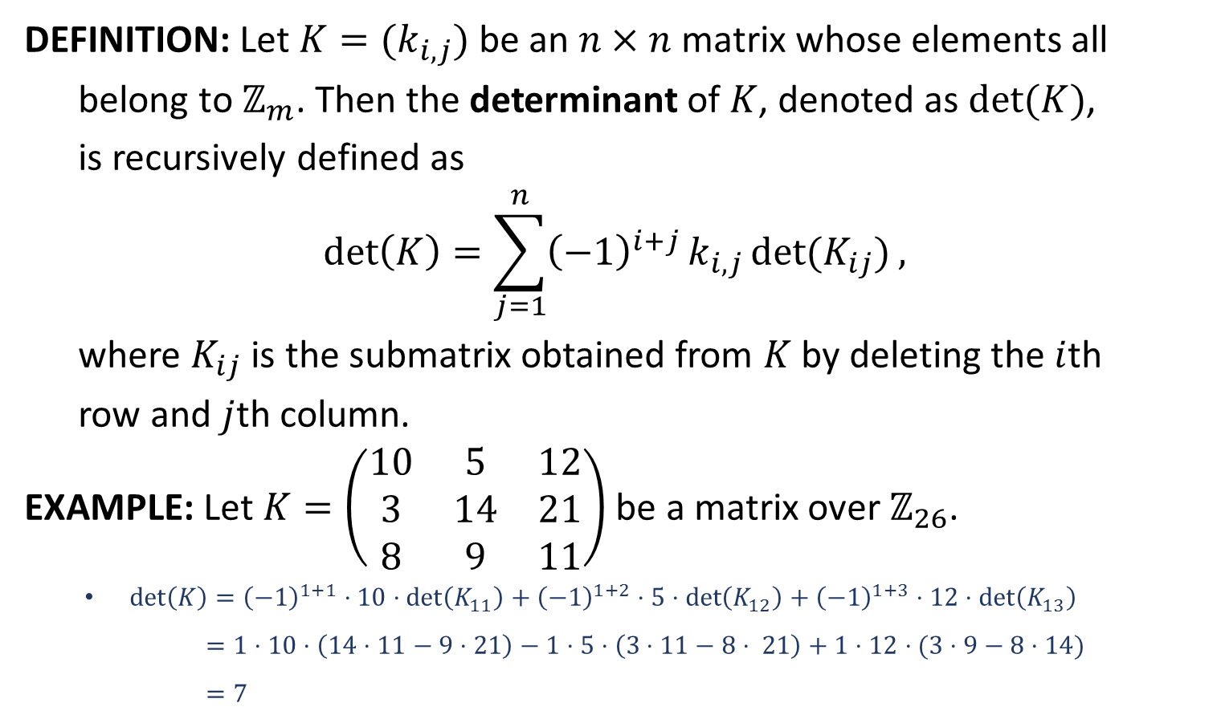
Matrix over $ℤ_{m}$
DEFINITION: Let $K=(k_{i,j})$ be an $n×n$ matrix whose elements all
belong to $ℤ_{m}$. Then the determinant of $K$, denoted as $det⁡(K)$,
is recursively defined as
$$\det\left(K\right)=\sum_{j=1}^{n}{{\left(−1\right)}^{i+j}}k_{i,j}\det{(K_{ij})},$$
where $K_{ij}$ is the submatrix obtained from $K$ by deleting the $i$th
row and $j$th column.
EXAMPLE: Let $K=\left(\begin{matrix}10 & 5 & 12 \\ 3 & 14 & 21 \\ 8 & 9 & 11\end{matrix}\right)$ be a matrix over $ℤ_{26}$.
$\det\left(K\right)={\left(−1\right)}^{1+1}⋅10⋅\det\left(K_{11}\right)+{\left(−1\right)}^{1+2}⋅5⋅\det\left(K_{12}\right)+{\left(−1\right)}^{1+3}⋅12⋅\det\left(K_{13}\right)$
$=1⋅10⋅\left(14⋅11−9⋅21\right)−1⋅5⋅\left(3⋅11−8⋅ 21\right)+1⋅12⋅(3⋅9−8⋅14)$
$=7$

Slide 12
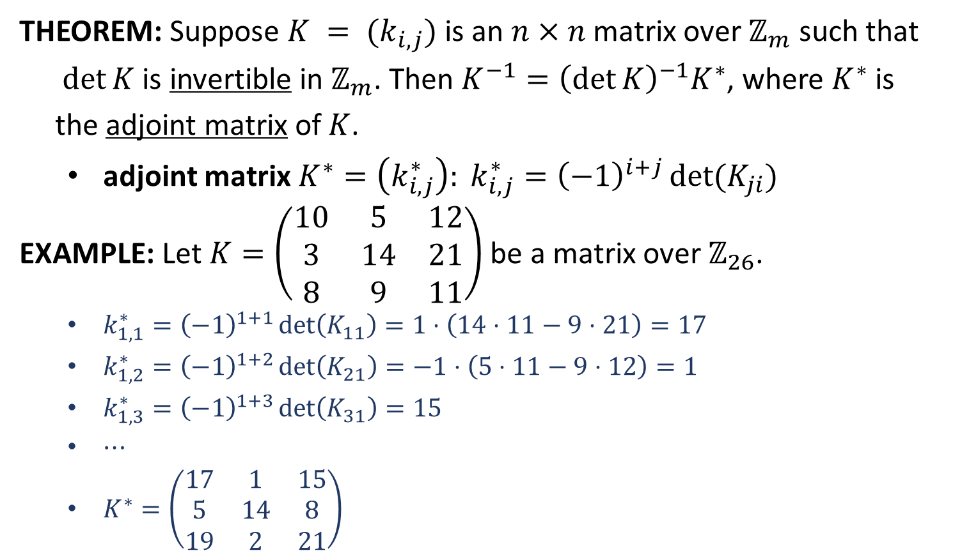
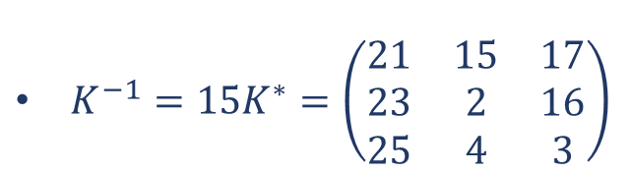

Matrix over $ℤ_{m}$
THEOREM: Suppose $K = (k_{i,j})$is an $n×n$ matrix over $ℤ_{m}$ such that
$det⁡K$ is invertible in $ℤ_{m}$. Then $K^{−1}={\left(\det{K}\right)}^{−1}K^{∗}$, where $K^{∗}$ is
the adjoint matrix of $K$.
adjoint matrix $K^{∗}=\left(k_{i,j}^{∗}\right): k_{i,j}^{∗}={\left(−1\right)}^{i+j}\det{(K_{ji})}$
EXAMPLE: Let $K=\left(\begin{matrix}10 & 5 & 12 \\ 3 & 14 & 21 \\ 8 & 9 & 11\end{matrix}\right)$ be a matrix over $ℤ_{26}$.
$k_{1,1}^{∗}={\left(−1\right)}^{1+1}\det\left(K_{11}\right)=1⋅\left(14⋅11−9⋅21\right)=17$
$k_{1,2}^{∗}={\left(−1\right)}^{1+2}\det\left(K_{21}\right)=−1⋅\left(5⋅11−9⋅12\right)=1$
$k_{1,3}^{∗}={\left(−1\right)}^{1+3}\det\left(K_{31}\right)=15$
$⋯$
$K^{∗}=\left(\begin{matrix}17 & 1 & 15 \\ 5 & 14 & 8 \\ 19 & 2 & 21\end{matrix}\right)$
${\left(\det{K}\right)}^{−1}=15$
$K^{−1}=15K^{∗}=\left(\begin{matrix}21 & 15 & 17 \\ 23 & 2 & 16 \\ 25 & 4 & 3\end{matrix}\right)$

Slide 13

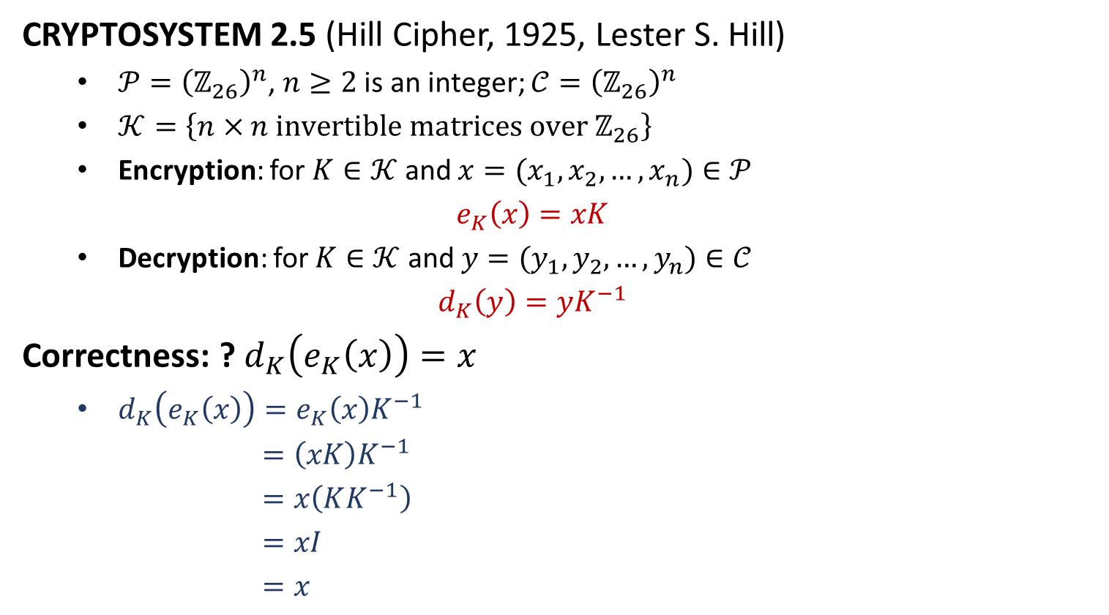
Hill Cipher
CRYPTOSYSTEM 2.5 (Hill Cipher, 1925, Lester S. Hill)
$𝒫={\left(ℤ_{26}\right)}^{n}$, $n≥2$ is an integer; $𝒞={\left(ℤ_{26}\right)}^{n}$
$𝒦=\left\{n×n \text{invertible} \text{matrices} \text{over} ℤ_{26}\right\}$
Encryption: for $K∈𝒦$ and $x=(x_{1},x_{2},…,x_{n})∈𝒫$
$$e_{K}\left(x\right)=xK$$
Decryption: for $K∈𝒦$ and $y=(y_{1},y_{2},…,y_{n})∈𝒞$
$$d_{K}\left(y\right)=yK^{−1}$$
Correctness: ? $d_{K}\left(e_{K}\left(x\right)\right)=x$
$d_{K}\left(e_{K}\left(x\right)\right)=e_{K}\left(x\right)K^{−1}$
$=\left(xK\right)K^{−1}$
$=x\left(KK^{−1}\right)$
$=xI$
$=x$
EXAMPLE: $K$ is from the last page
$e_{K}\left("bad"\right)=?$
$x=(1,0,3)$
$y=xK=(8,6,19)$
$y="IGT"$

Slide 15
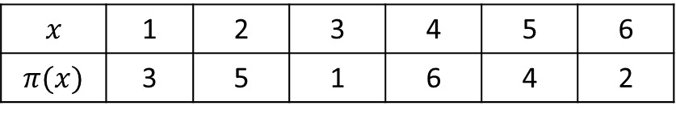
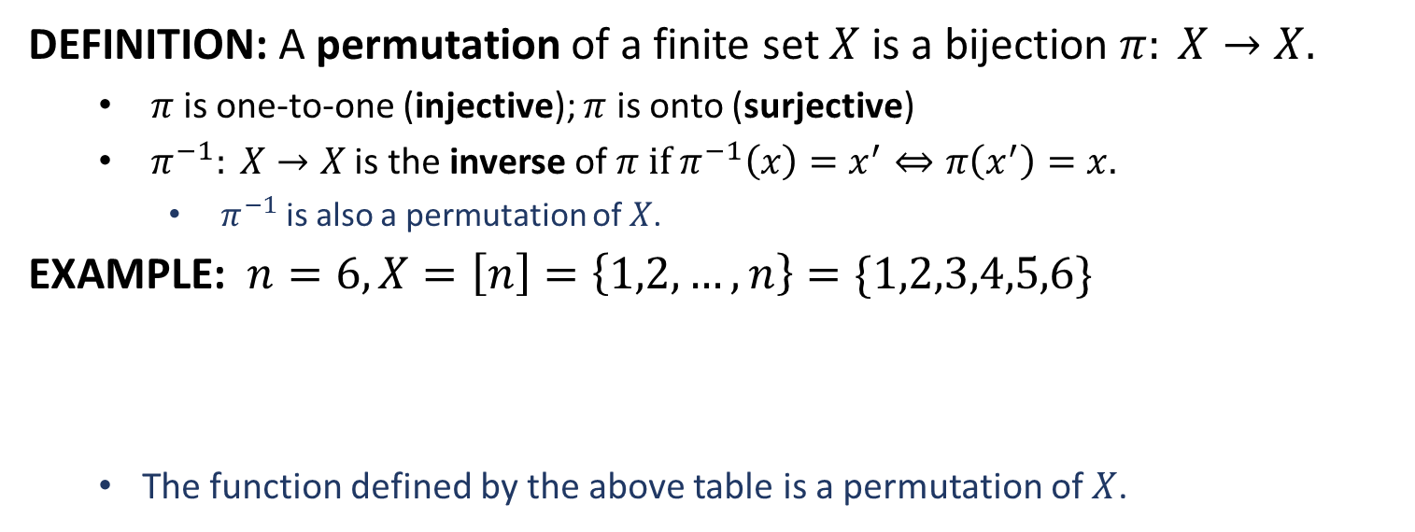
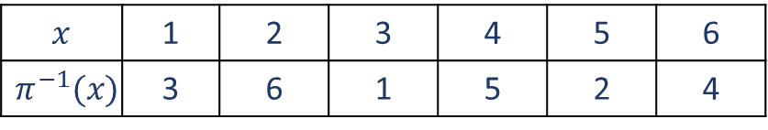
Permutation
DEFINITION: A permutation of a finite set $X$ is a bijection $π: X→X.$
$π$is one-to-one (injective); $π$ is onto (surjective)
$π^{−1}: X→X$ is the inverse of $π$ if $π^{−1}\left(x\right)=x^{′}⇔π\left(x^{′}\right)=x.$
$π^{−1}$is also a permutation of $X$.
EXAMPLE: $n=6, X=\left[n\right]=\left\{1,2,…,n\right\}=\{1,2,3,4,5,6\}$
The function defined by the above table is a permutation of $X$.
$$x$$ | 1 | 2 | 3 | 4 | 5 | 6
$$π(x)$$ | 3 | 5 | 1 | 6 | 4 | 2
$$x$$ | 1 | 2 | 3 | 4 | 5 | 6
$$π^{−1}(x)$$ | 3 | 6 | 1 | 5 | 2 | 4

Slide 16
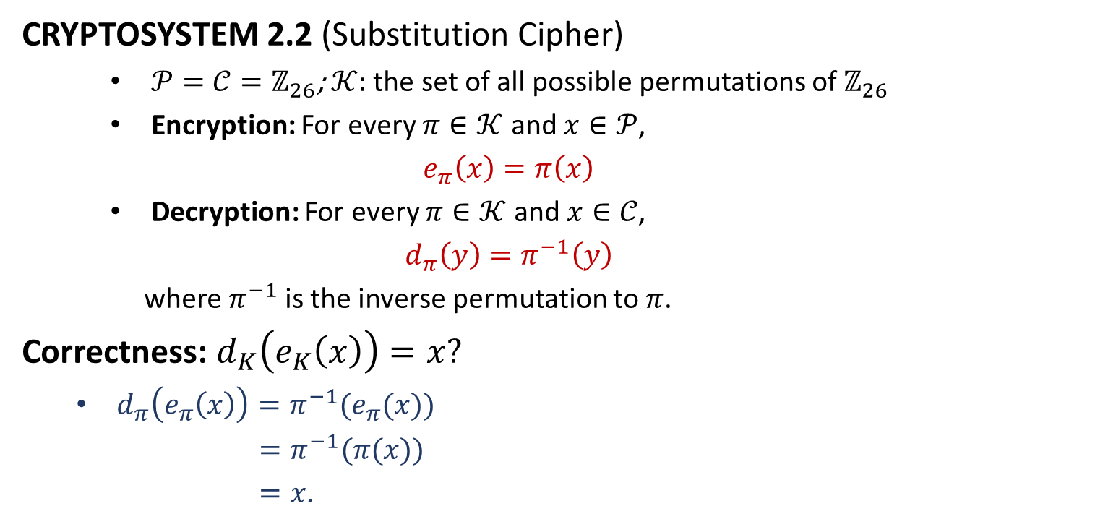
Substitution Cipher
CRYPTOSYSTEM 2.2 (Substitution Cipher)
$𝒫=𝒞=ℤ_{26}$; $𝒦:$ the set of all possible permutations of $ℤ_{26}$
Encryption: For every $π∈𝒦$ and $x∈𝒫$,
$$e_{π}\left(x\right)=π\left(x\right)$$
Decryption: For every $π∈𝒦$ and $x∈𝒞$,
$$d_{π}\left(y\right)=π^{−1}\left(y\right)$$
where $π^{−1}$is the inverse permutation to $π$.
Correctness: $d_{K}\left(e_{K}\left(x\right)\right)=x?$
$d_{π}\left(e_{π}\left(x\right)\right)=π^{−1}(e_{π}(x))$
$=π^{−1}(π(x))$
$=x$.

Slide 17
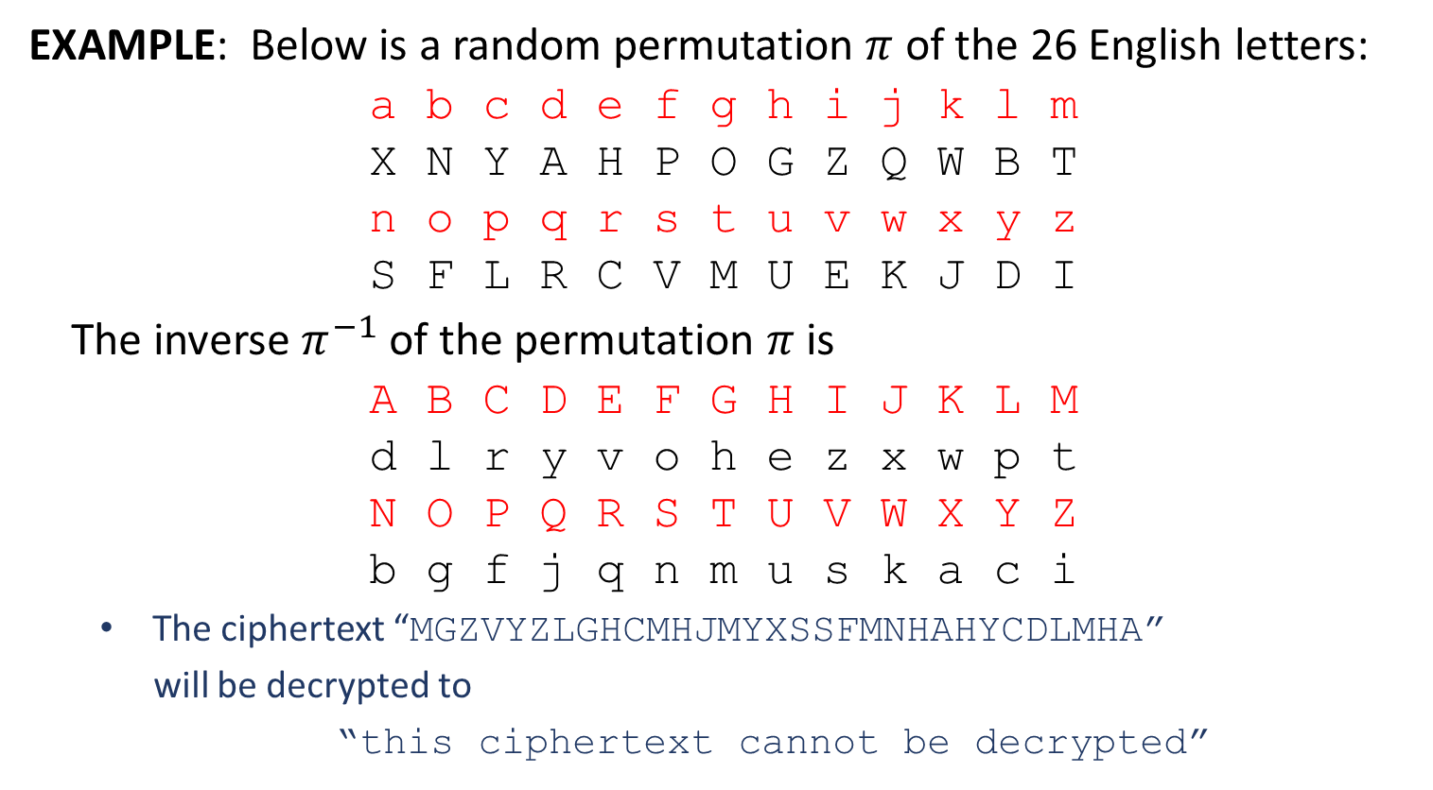
Substitution Cipher
EXAMPLE: Below is a random permutation $π$ of the 26 English letters:
a b c d e f g h i j k l m
X N Y A H P O G Z Q W B T
n o p q r s t u v w x y z
S F L R C V M U E K J D I
The inverse $π^{−1}$ of the permutation $π$ is
A B C D E F G H I J K L M
d l r y v o h e z x w p t
N O P Q R S T U V W X Y Z
b g f j q n m u s k a c i
The ciphertext “MGZVYZLGHCMHJMYXSSFMNHAHYCDLMHA”
will be decrypted to
“this ciphertext cannot be decrypted”

Slide 18
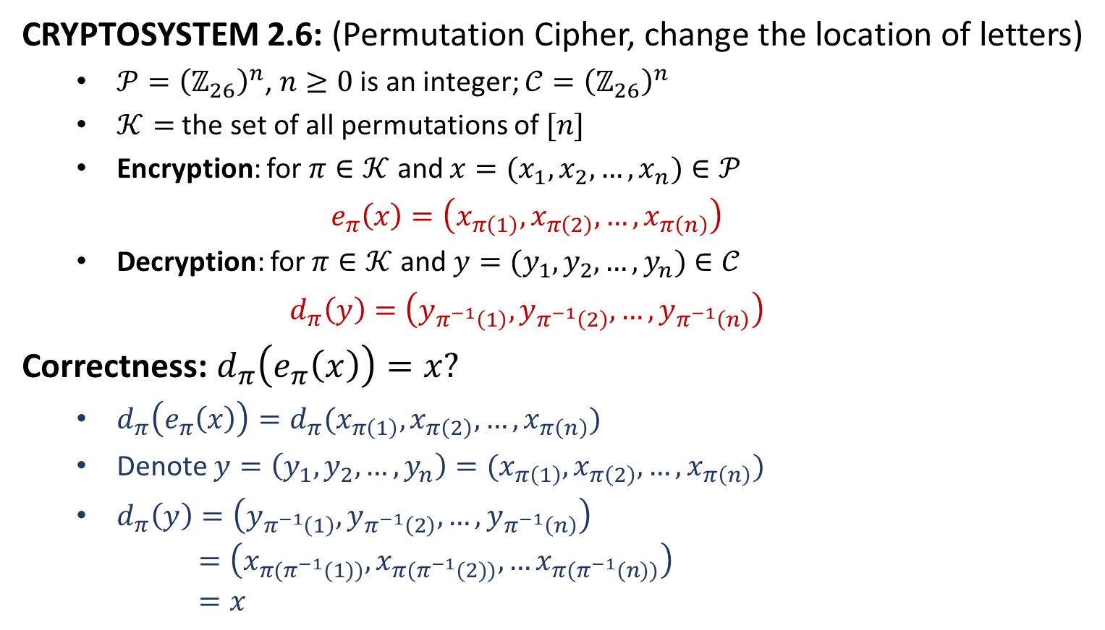
Permutation Cipher
CRYPTOSYSTEM 2.6: (Permutation Cipher, change the location of letters)
$𝒫={\left(ℤ_{26}\right)}^{n}$, $n≥0$ is an integer; $𝒞={\left(ℤ_{26}\right)}^{n}$
$𝒦=$ the set of all permutations of $[n]$
Encryption: for $π∈𝒦$ and $x=(x_{1},x_{2},…,x_{n})∈𝒫$
$$e_{π}\left(x\right)=\left(x_{π\left(1\right)},x_{π\left(2\right)},…,x_{π\left(n\right)}\right)$$
Decryption: for $π∈𝒦$ and $y=(y_{1},y_{2},…,y_{n})∈𝒞$
$$d_{π}\left(y\right)=\left(y_{π^{−1}\left(1\right)},y_{π^{−1}\left(2\right)},…,y_{π^{−1}\left(n\right)}\right)$$
Correctness: $d_{π}\left(e_{π}\left(x\right)\right)=x?$
$d_{π}\left(e_{π}\left(x\right)\right)=d_{π}(x_{π\left(1\right)},x_{π\left(2\right)},…,x_{π\left(n\right)})$
Denote $y=\left(y_{1},y_{2},…,y_{n}\right)=(x_{π\left(1\right)},x_{π\left(2\right)},…,x_{π\left(n\right)})$
$d_{π}\left(y\right)=\left(y_{π^{−1}\left(1\right)},y_{π^{−1}\left(2\right)},…,y_{π^{−1}\left(n\right)}\right)$
$=\left(x_{π(π^{−1}(1))},x_{π(π^{−1}(2))},…x_{π(π^{−1}(n))}\right)$
$=x$

Slide 19
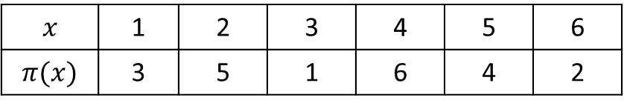
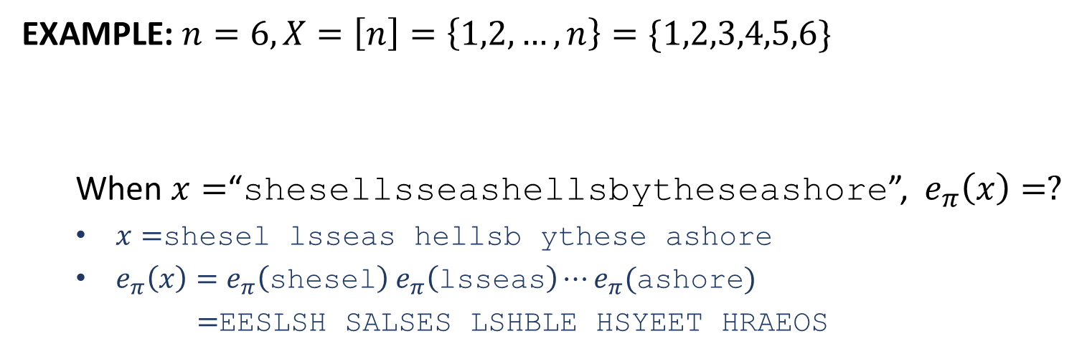
Permutation Cipher
EXAMPLE: $n=6, X=\left[n\right]=\left\{1,2,…,n\right\}=\{1,2,3,4,5,6\}$
When $x=$“shesellsseashellsbytheseashore”, $e_{π}\left(x\right)=?$
$x=$shesel lsseas hellsb ythese ashore
$e_{π}\left(x\right)=e_{π}\left(\text{shesel}\right) e_{π}\left(\text{lsseas}\right)⋯e_{π}(\text{ashore})$
$=$EESLSH SALSES LSHBLE HSYEET HRAEOS
$$x$$ | 1 | 2 | 3 | 4 | 5 | 6
$$π(x)$$ | 3 | 5 | 1 | 6 | 4 | 2

